Slide 1

8 Rules for Better Design
or ‘Checklists & the Death of the Master Builder’

Slide 2


Hobbs
Valorem Reply

Slide 3
PRE-COGNITIVE ATTRIBUTES
THE UNCONSCIOUS BRAIN AT WORK

Slide 4
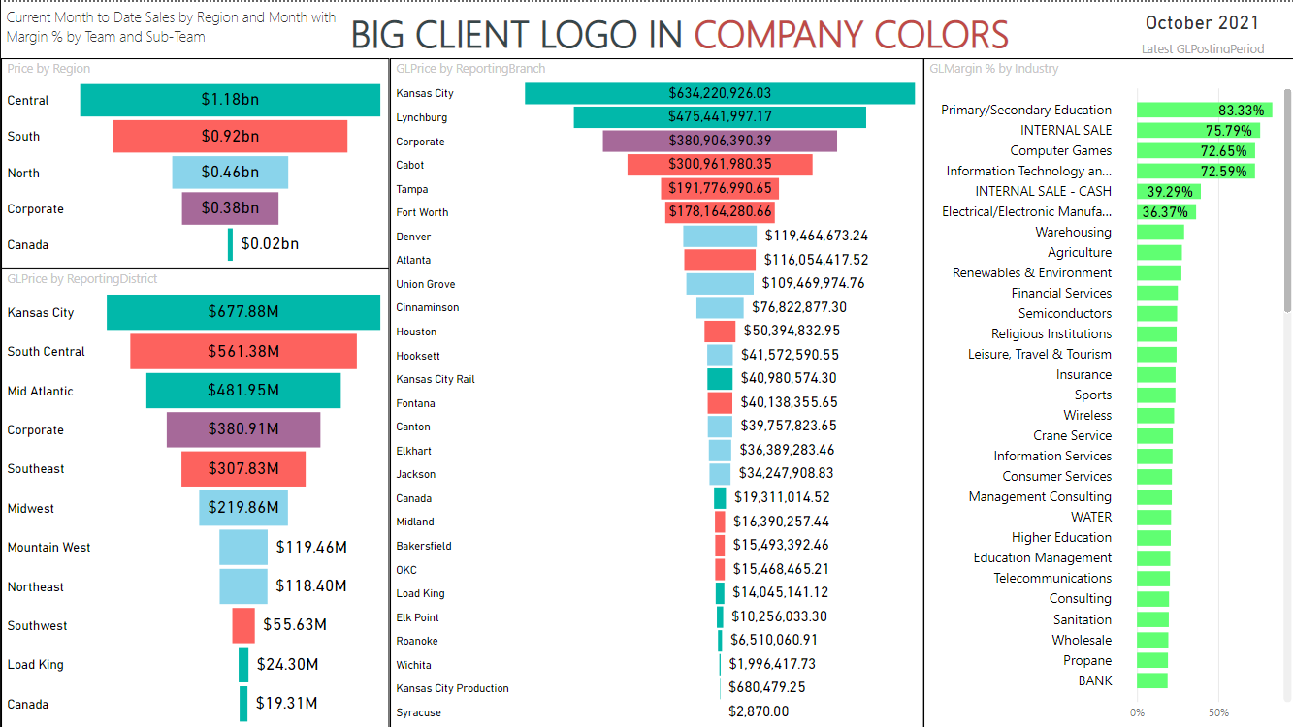

Slide 5
READING MATTERS

Slide 6
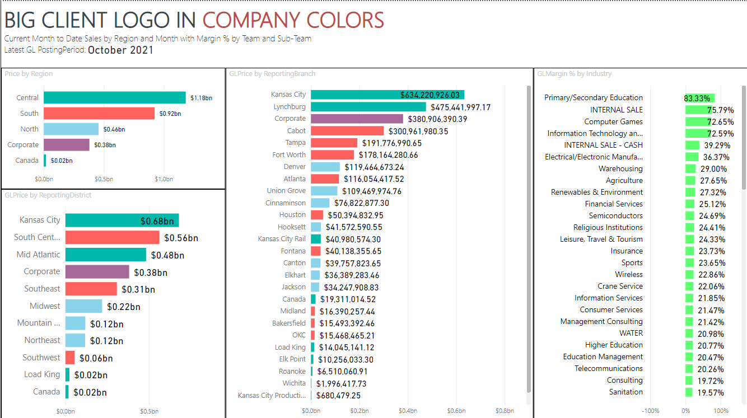
Notes:
What I changed:
Moved header items to align and read left to right, top to bottom
Left aligned all visuals (this required replacing the visual type)

Slide 7
SIZE MATTERS
SIZE
MATTERS

Slide 8
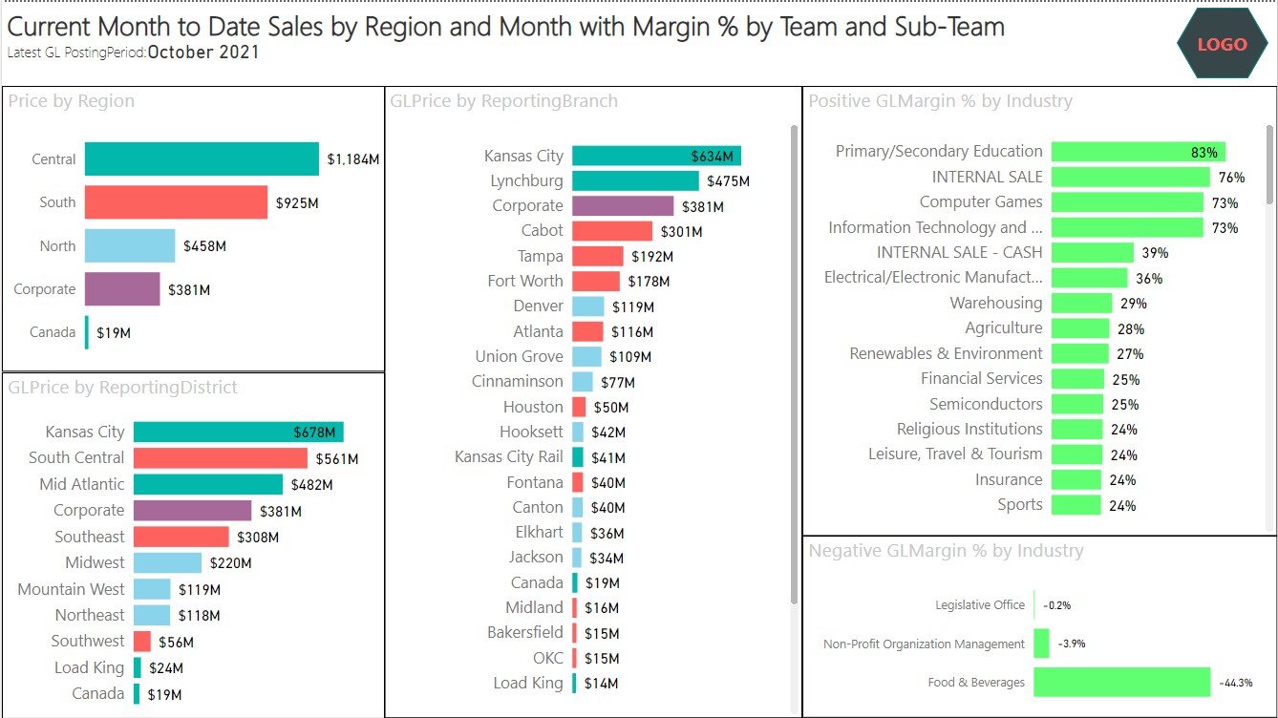
Notes:
What I changed:
Replaced logo-with-company-title with just logo
Made report header bigger (h1)
Made visual headers bigger (h3)
To make visual on the right look the right size, I split it into x2, one negative and one positive
Removed X axis labels (since we already had datapoint labels)
Set a minimum category width
Set row font size to 12
Set Y axis maximum label size to 50%
Resized visuals to fit larger row labels
Set data label groupings to Millions and removed extra decimals

Slide 9
COLOR MATTERS MATTERS

Slide 10
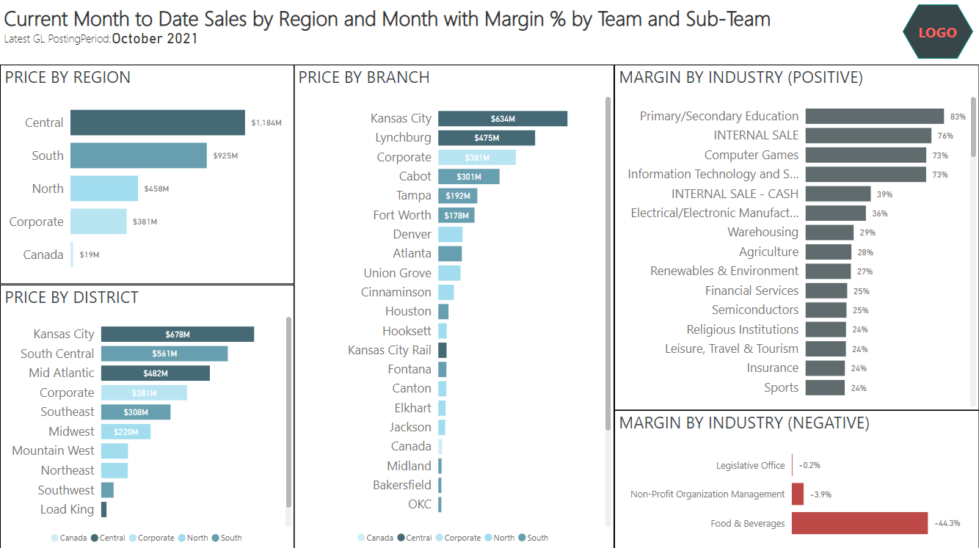
Notes:
What I changed:
Neutral, mono-chromatic color scheme in most places
Picked a “means nothing color” (dark grey)
Matched data label color to fit with background
Made a bad thing red (but didn’t make a good thing green. TSHIRT JOKE)
Added in legends on the bottom center, with no title

Slide 11
DISTANCE MATTERS MATTERS

Slide 12
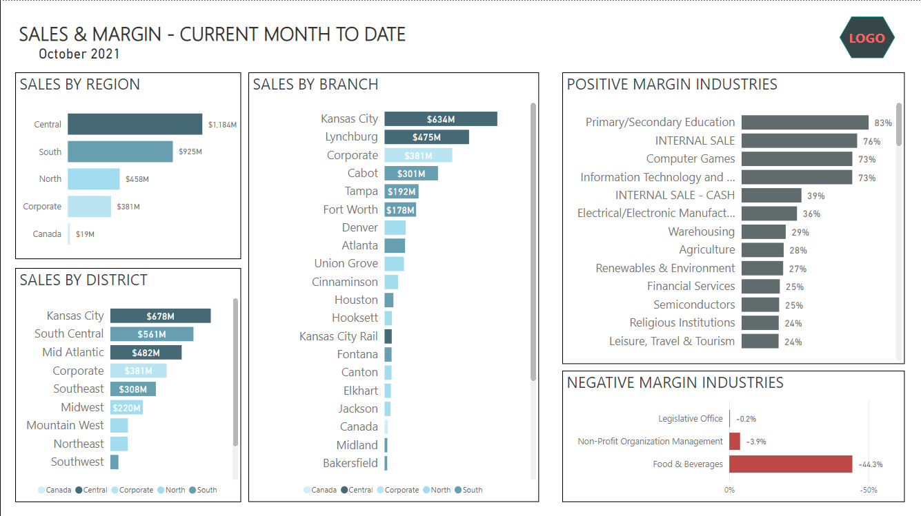
Notes:
What I changed:
Rearranged all elements to give us a whitespace border
Rearranged price and margin to have some space between them
In rearranging the titles, I notice how bad the title is. I re-write it.
I also think I can remove some extra text, and make the date stand on its own
This makes me re-think my visual labels a bit as well
So I’m cheating a bit here, as not all of this is strictly “Distance”. It would fit better under “Reading Matters”

Slide 13
GROUPING MATTERS MATTERS

Slide 14
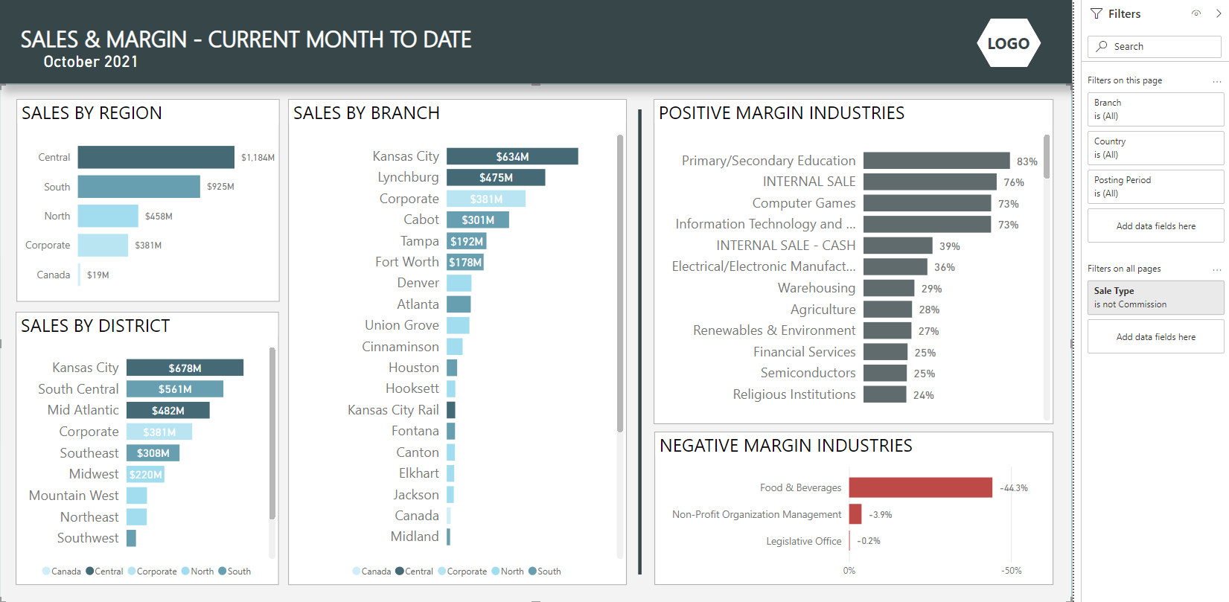
Notes:
What I changed:
I added a background image which grouped the header away from the visuals
I put a bar between the Sales and Margin visuals
I reduced the starkness of the border line from black to grey
I turned on the Filter Pane

Slide 15
SIMILARITY MATTERS MATTERS

Slide 16
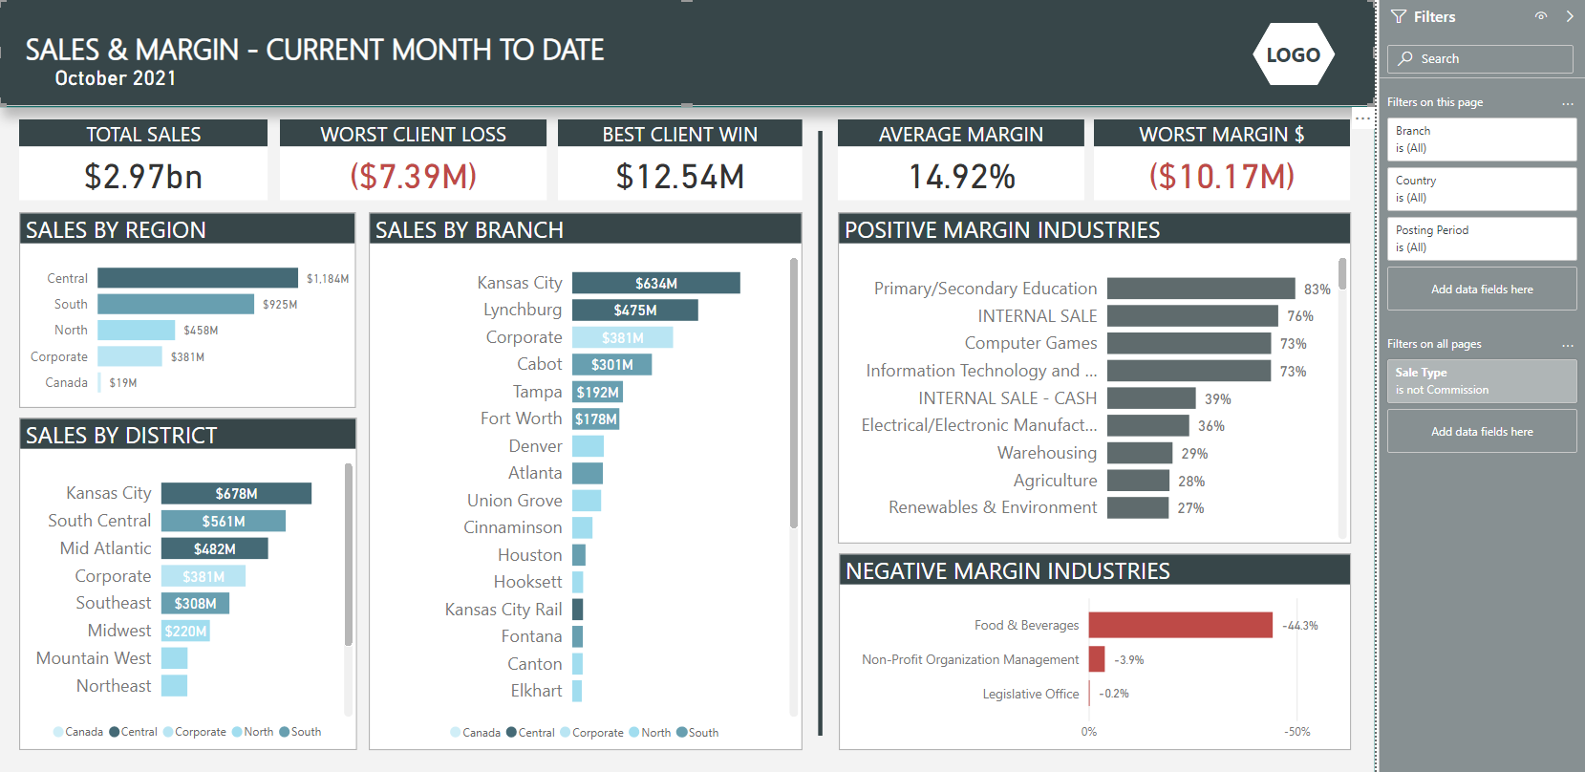
Notes:
Things I changed:
I added a background color to titles to visually make them look like headers
I colored the Filter pane uniquely to make it a separate group
I thought about how I could change the margin visuals to be visually different, but didn’t come up with anything
Instead, I decided to add some KPIs along the top. Those that I wanted to relate to “Bad”, I made the same color as the bottom right.

Slide 17
MATTERS MATTERS MATTERS MATTERS MATTERS MATTERS MATTERS MATTERS MATTERS MATTERS
FOCUS

Slide 18
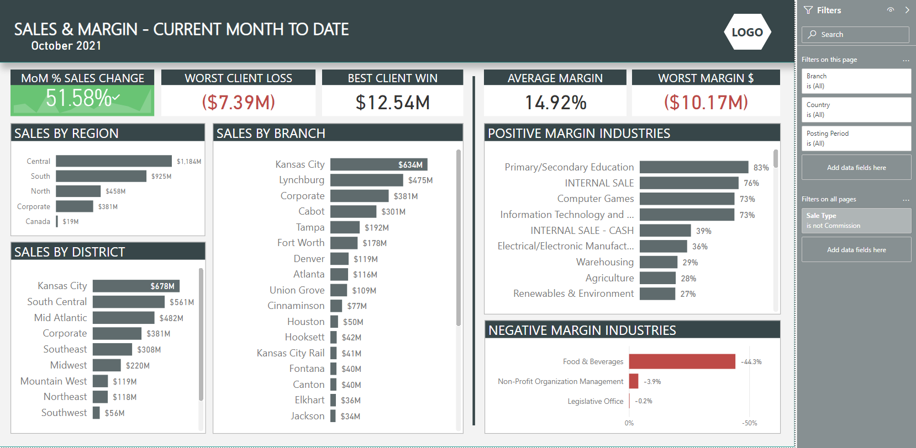
Notes:
What I changed:
Removed color coding and legends from left-hand visuals (distracting and can be achieved by clicking
Added a KPI tile in the top left

Slide 19

EXPERIENCE MATTERS

Slide 20
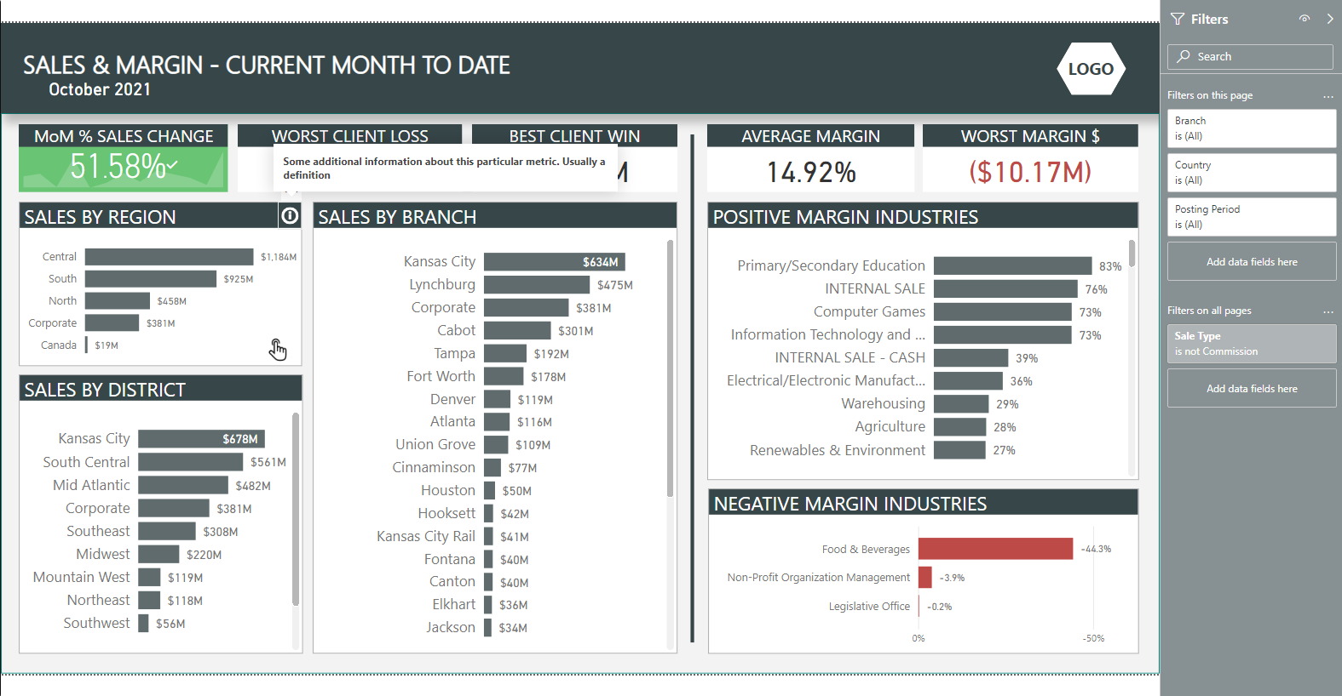
Notes:
What I changed:
Added a ‘click’ icon to the first visual to draw attention to interactivity. I could do it everywhere, but that’s not necessary
Could also have added a note
Added an ‘info’ icon to the top right corner of a visual. Often I will do this on lots of visuals. Added a tooltip.

Slide 22

Do me a favor…
biz.bo/035246

Slide 23
THE ‘WHAT MATTERS’ CHEAT SHEET
Reading
Text alignment, grid-like layout, left-to-right priority
Size
Font, visual, titles, objects
Color
Consistent, mono-chromatic, meaningful
Distance
White space, header balance, visual padding
Grouping
Dividers, meaningful distance, filters, background blocking
Similarity
Meaningful visual-types, matching text styles
Focus
Action oriented, story telling, F/Z layout, color
Experience
Icons, familiar layouts, red-is-bad and green-is-good

Slide 24
THANKS!
linkedin.com/in/iamhobbs
github.com/IAmHobbs/RulesOfDesign
Youtube (or just search for “Valorem TnT”)
jhobbs@valorem.com

